Slide 1
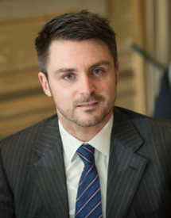
Marco Barroero
AVP @ Revantage, A Blackstone Company
Marco has joined Revantage – A Blackstone Company - in January 2021 with the title of Assistant Vice President. He will help to build and coordinate the new Valuation & Portfolio Reporting team launched to service Blackstone property companies across the EMEA region.
Prior to joining Revantage, Marco was with Duff & Phelps at the London office, leading the Real Estate Valuation Team with the title of Vice President. At Duff & Phelps Marco advised on valuation topics across all real estate asset classes for a variety of entities including private equity across EMEA. His work included valuation and consulting for financial reporting purposes under IFRS, transaction opinions, and investment property portfolio tracking for assurance testing.
Marco holds a MSc in Structural Engineering, from Politecnico of Turin, Italy and a MSc in Real Estate Investment & Finance (grade Distinction), from Henley Business School – University of Reading.
He is a member of the Royal Institution of Chartered Surveyors (MRICS) – Chartered Valuation Surveyor designation, a certified RICS Registered Valuer and past member of the Italian association of engineers. Furthermore, he joined AICI in 2013, a leading Italian real estate association.
Revantage, A Blackstone Company
London

